Slide 1
Kristopher Kern
Life Story Interview
Chaminade University

Slide 2
Description of Kristopher
Full Name: Kristopher Curtis Kern
Born: September 24, 1980 in Honolulu, HI
High School: Maryknoll School, Honolulu, HI
Undergraduate: University of San Francisco, San Francisco, CA
Studied: Politics & Philosophy
Graduate School: Chaminade University, Honolulu, HI
Occupation: Vice Principal, Maryknoll School

Slide 3
Description of Kristopher
Family: (Provide whatever information is given to you)
Youngest of Three Children
Twin Sisters are 12 years older, each with three kids
Mother: Filipino & Spanish
Father: Irish & German
Catholic
Raised in Pearl City, HI, lived in same house since birth
5 year old Boxer named Moses
Enmeshed Family

Slide 4
Description of Kristopher
Personality
Considers himself the Black Sheep
Enjoys working out, running, anything athletic
Stress Reliever: Working Out & Saturday Beach Days with friends
Introvert in social situations because of lack of confidence
More intuitive in taking in information
Split down the middle between Thinking & Feeling when making a decision
Perception is key in referring to the outer life
Use graph on next slide to answer 4 parts:
Extrovert vs. Introvert: Are you outwardly or inwardly focused?
Sensing vs. Intuition: How do you prefer to take in information?
Thinking vs. Feeling: How do you prefer to make decisions?
Judging vs. Perceiving: How do you prefer to live your outer life?

Slide 5
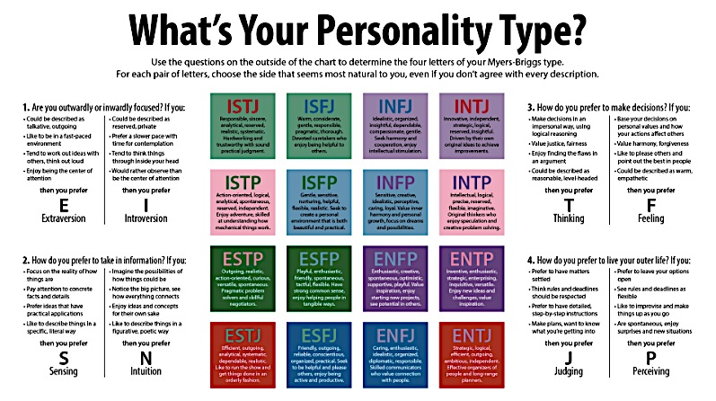

Slide 6
Early Adulthood Life Event: College
BASIC DESCRIPTION OF EVENT
@ Age 17, Kristopher left for college to the University of San Francisco
First time away from home & being independent
Sister went to school there
This was not his first choice
Was recruited to play baseball
Physically: GAINED WEIGHT
Emotionally, grew A LOT
Experimented with drugs and alcohol
Graduated from high school with a GPA of 3.7, first semester at college was a 2.7
Original goal was to be a politician and a lawyer, yet chose a different path his Senior Year to forgo Law School and instead attend UH Manoa
Loved living in San Francisco because of the diversity and the atmosphere
Graduated in Four Years
Worked multiple jobs (Catering, Cafeteria Manager, Abercrombie & Fitch, Athletics)

Slide 7
Early Adulthood Life Event: College
DESCRIPTION/JUDGMENT of EVENT
How does this event relate to a stage in life span development?
What theory provides justification in understanding why this event happened?

Slide 8
Early Adulthood Life Event: College
DESCRIPTION/JUDGMENT of EVENT
How does this event relate to a stage in life span development?
Kristopher’s event of going to college is an example of him going through the Early Adulthood stage in Life Span Development. Being that this stage of human development centers on the individual “finding their way”, Kristopher made the choice to go to college and explore his purpose in life. This exploration is a key component of this stage. Belsky (2013) describes the function of this stage as, “exploration – trying out options before committing to adult roles” (p. 300). Kristopher’s change in his original goal of becoming a Lawyer/Politician changes in his Senior year where he realizes that lying was difficult for him. Kristopher found a passion for helping others in his internship for Hawaii Adult Probation Office during the summer between his Junior and Senior Year in college. This change in career path proves this switch in commitment before adult roles, a component of this life stage of development.

Slide 9
Early Adulthood Life Event: College
DESCRIPTION/JUDGMENT of EVENT
What theory provides justification in understanding why this event happened?
Marcia’s Identity Statuses provides a foundation into understanding why this event happened for Kristopher. One of the stages in Marcia’s theory is called Moratorium. During this stage the individual actively searches for their purpose in life. Belsky (2013) describes this stage as an, “exciting, healthy search for an adult self” (p. 307). Kristopher’s choice to forgo Law School and understand that his purpose was to help others in the field of psychology shows that Kristopher made the choice in his purpose in life. Marcia’s theory supports Kristopher’s wrestling between law school and psychology suggesting that Kristopher was still searching for his identity.

Slide 10
Expectations
Please use this template to complete TWO LIFE STORY interviews.
You will then present one of these to the class
You will need THREE Major Life Events
Get as much details as possible
The first slide is basic descriptors of the event, from the interviewee’s perspective
The second slide is YOUR interpretation
For the second slide, be sure to answer the two questions.

